Slide 1
Raspberry Pi

Slide 2
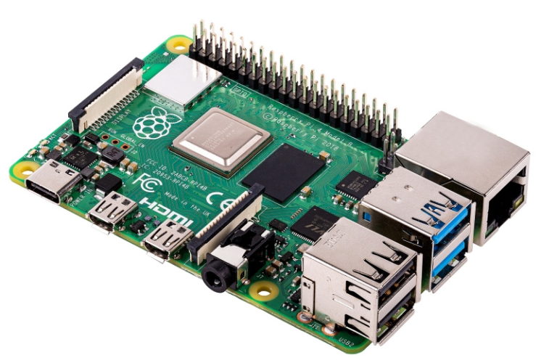
Raspberry Pi
The Raspberry Pi is a small computer board about the size of a credit card
It was developed in the United Kingdom by the Raspberry Pi Foundation
Originally designed to promote basic computer science teaching in schools
Since its introduction2012, more than 46 million Raspberry Pi boards have been sold
The Raspberry Pi has become tremendously popular among kids and electronics hobbyists, experienced makers, tinkerers, and even computer scientists

Slide 3
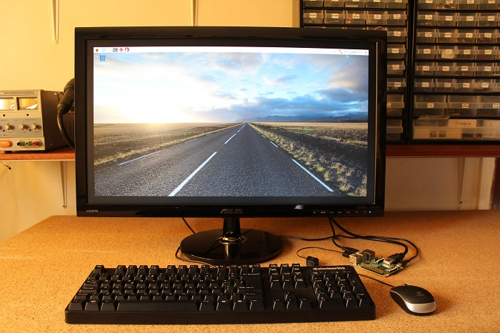
Raspberry Pi – Desktop computer
In some way, you can look at the Raspberry Pi like a normal computer
It has a processor, RAM, USB ports to plug a keyboard and a mouse, an HDMI port to plug a TV or monitor, and you can even connect it to the internet.
You can do most things you do with a regular computer like web browsing, document editing, playing games, coding, and much more. The figure below shows the Raspberry Pi 3 set up as a desktop computer.
Raspberry Pi Headless – without monitor, mouse, keypad – using remote access

Slide 4
Raspberry Pi 3 features
Quad Core 1.2GHz Broadcom BCM2837 64bit CPU
1GB RAM
BCM43438 wireless LAN and Bluetooth Low Energy (BLE) on board
100 Base Ethernet
40-pin extended GPIO
4 USB 2 ports
4 Pole stereo output and composite video port
Full size HDMI
CSI camera port for connecting a Raspberry Pi camera
DSI display port for connecting a Raspberry Pi touchscreen display
Micro SD port for loading your operating system and storing data
Upgraded switched Micro USB power source up to 2.5A

Slide 5
Raspberry Pi – Installing OS – SD card
Your Raspberry Pi doesn't come with an operating system pre-installed
Rather than being a disadvantage, this means you can choose from a wide selection of operating systems (OSs). Any of these can be flashed to your Raspberry Pi's SD card
Raspberry Pis boot from microSD cards. You'll need to ensure you have a microSD card with the right capacity for the operating system, plus extra for storage.
As a rule, given the size of most operating systems, a 16GB microSD card should be the minimum you should consider. However, when choosing an SD card to buy you may find that a 32GB card is almost as affordable.

Slide 6
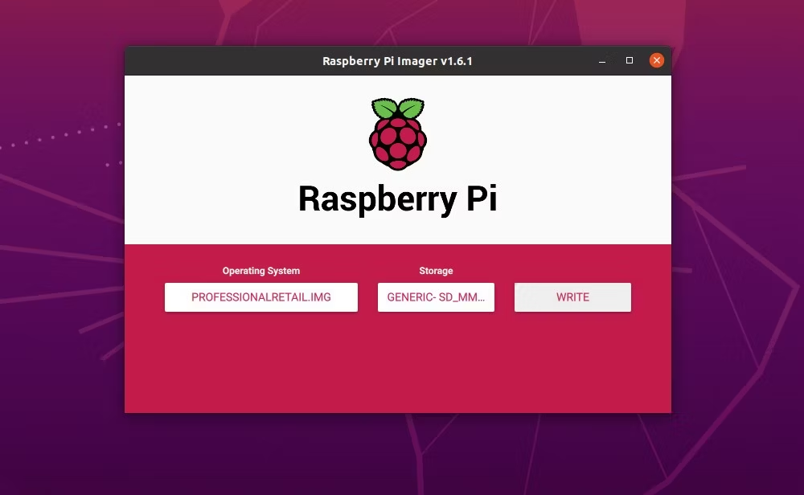
Raspberry Pi – OS Installation methods
Raspberry Pi operating systems are available as a disk image, either ISO or IMG format.
Raspberry Pi Imager - Available from the official Raspberry Pi website, Raspberry Pi Imager is a utility that writes an operating system to your Pi's SD card. Raspberry Pi users will be able to download and use the Raspberry Pi Imager, available for Windows, macOS and Ubuntu
Select the OS from among a list, select Storage (SD card) and click on Write button. Once you’ve selected an operating system from the available options, the utility reads the relevant file directly from Raspberry Pi website and writes it straight to the SD card

Slide 7
OS installation - NOOBS
This precursor to the Raspberry Pi Imager is an acronym for New Out Of Box Software installation system.
Download: NOOBS
To use NOOBS, unzip the download file and copy the contents to a microSD card inserted in your computer. Once you've done this, eject the SD card, insert it into your Raspberry Pi, and power it up.
Other option - buy a pre-loaded NOOBS SD card from your Raspberry Pi Approved Reseller

Slide 8
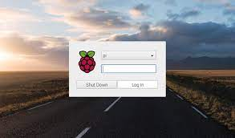
On bootup - Desktop
The username by default for the Raspbian operating system is pi . The default password for logging into Raspbian is raspberry

Slide 9
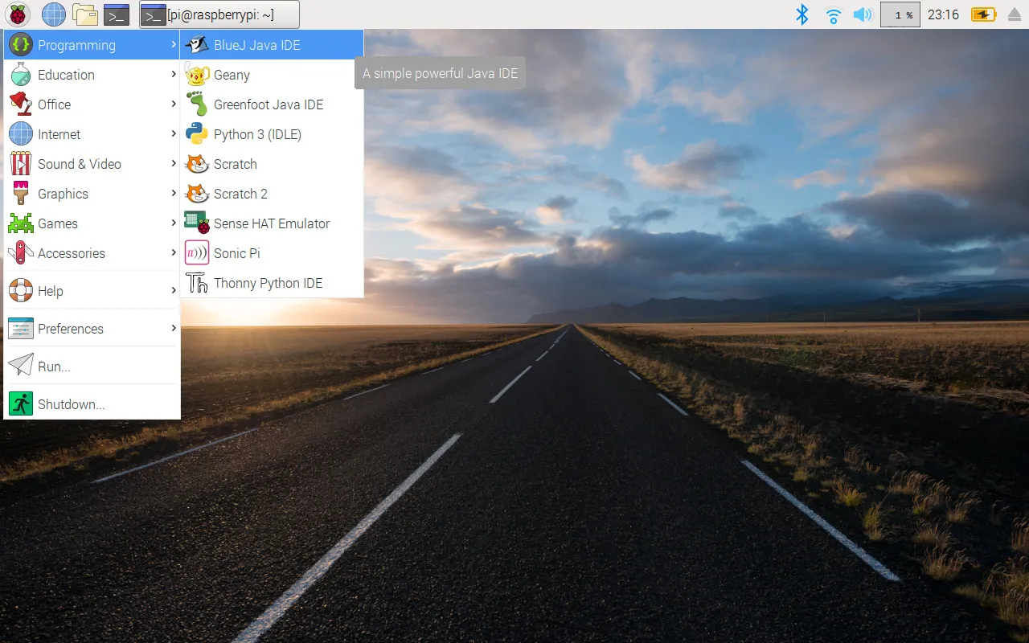
Rasbian OS - Desktop

Slide 10
SSH – Remote access
SSH (also known as ‘Secure Shell’) is an encrypted networking technology that enables you to manage computers from the command line over a network.
SSH is handy if you want to quickly connect to a Raspberry Pi from a terminal window on another computer. It’s also ideal for lightweight distro installations that don’t have graphical interfaces, and projects that don’t have a screen (such as robots). It’s especially useful when creating Internet of Things (IoT) projects, as these may be embedded inside other hardware.
You don’t need to install any software to start using Secure Shell. Linux, macOS, and Windows 10 have the SSH command-line application installed by default.

Slide 11
SSH – Secure Shell
Secure Shell (SSH) enables you to access the command line of a Raspberry Pi from another computer or device on the same network.
This is very handy for quickly installing software or editing configuration files.
SSH is pre-installed on Linux, Mac and some Windows operating systems and can also be installed on mobile devices.
SSH does not provide any visual access to the Raspberry Pi Desktop.

Slide 12
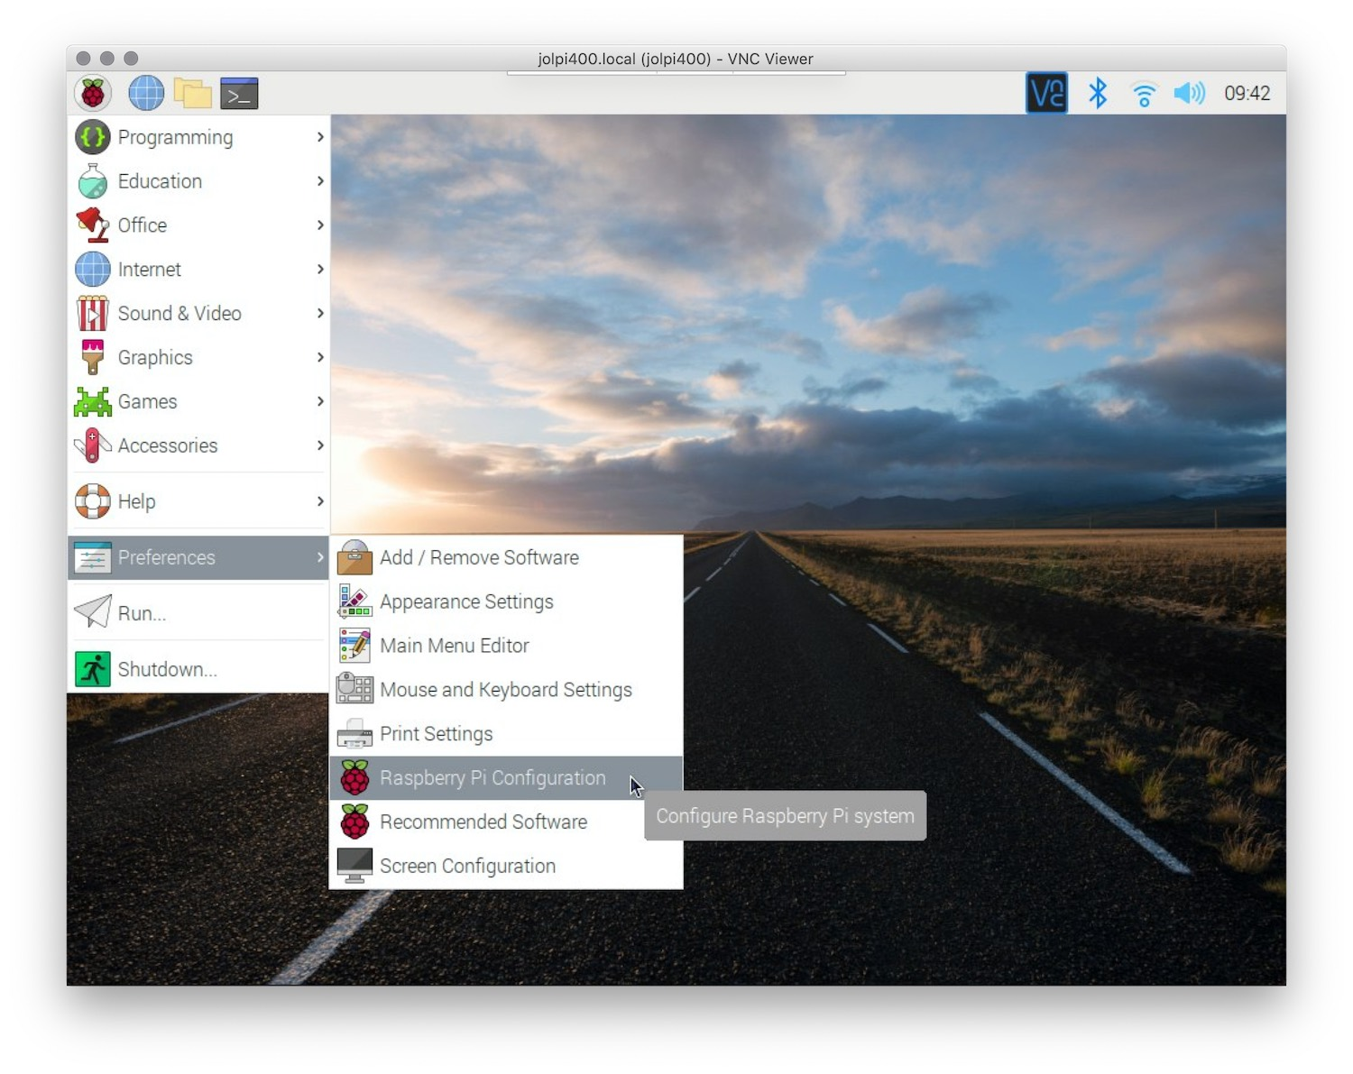
Enable SSH on RPi
By default, SSH is disabled on the Raspberry Pi. It is however very easy to enable it, both using the Desktop and via the terminal. To enable SSH via the Desktop, go to the start menu > Preferences > Raspberry Pi Configuration.

Slide 13
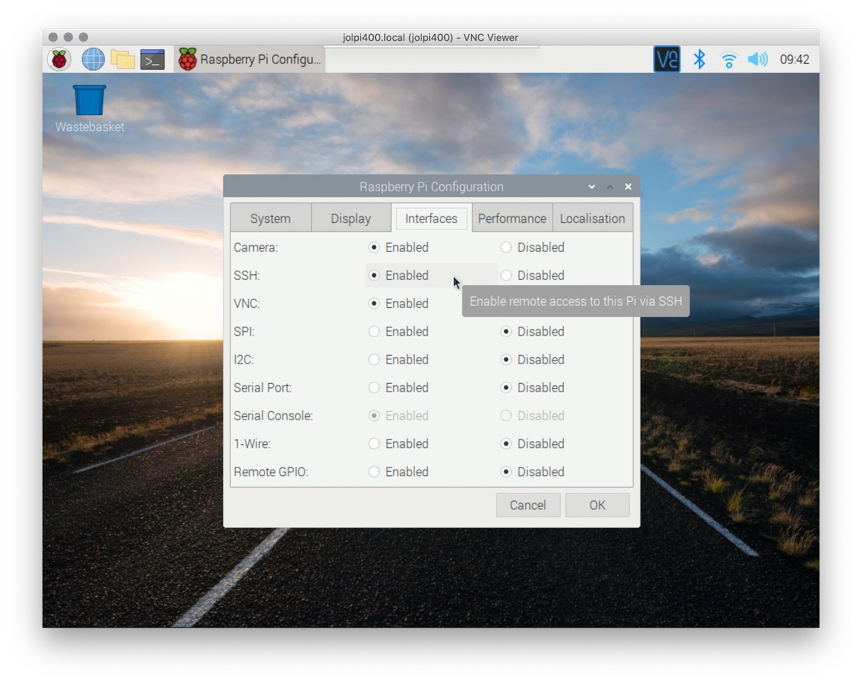
Enable SSH on RPi
Now click on Interfaces and click enable next to SSH and click OK.

Slide 14
Connecting via SSH
Now SSH is enabled, we need to know the hostname of the Raspberry Pi or use its IP address to connect to it. To know the ip address, on your Raspbery Pi type in:
hostname -I
Now to connect, on the host computer open a terminal window and type in
ssh [username]@[hostname].local
or
ssh [username]@[ip address]

Slide 15
SSH on the host
SSH is standard available on Linux distributions and on Mac so should work automatically.
To enable ssh on a Windows 10 computer, make sure it has the October 2018 Update or later and go to Settings > Apps > Apps & features > Manage optional features > Add a feature, and choose to install OpenSSH Client.
On other Windows installations you may need to install an SSH client, of which PuTTY is the most commonly used. Go to putty.org, download the 64-bit MSI (Windows Installer), and open it to run the installer. Now launch PuTTY, set the Host Name (or IP address) field, Port to 22, and Connection type should be set to SSH. Now click Open and a new terminal window should appear prompting you for a user name.

Slide 16
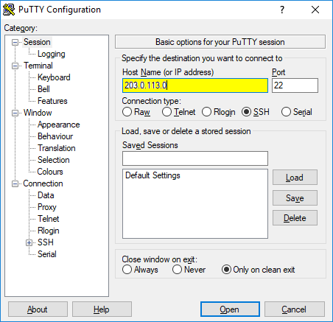
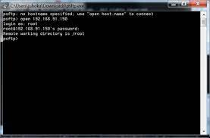
PuTTY

Slide 17
SSH commands
apt-get update
This is one of the most used SSH commands on every Linux distribution. It updates the package list and shows information on the newest version of packages and their dependencies.
apt-get upgrade
Following the update command, apt-get upgrade is a must know SSH command. By running it, it will download the new versions of packages based on the update performed before, and install them.
mk-dir
Another must-know SSH command, mkdir will create a new folder. By running the command mkdir Projects you create a new folder called "Projects."
rm
The rm command removes a folder or file. By running the command rm Projects you remove the folder called "Projects."

Slide 18
SSH commands
touch
One of the most used SSH commands used to create a file. By running the command touch readme.txt you will create the file readme.txt on your file system.
ls
When running the ls command, you are listing all the files from the folder you are located.
nano
A commonly used SSH editor, Nano allows you to edit files right in the SSH windows. By running the command nano followed by the location of the file, you open the file for editing, making it one of the most used Raspberry Pi SSH commands.

Slide 19
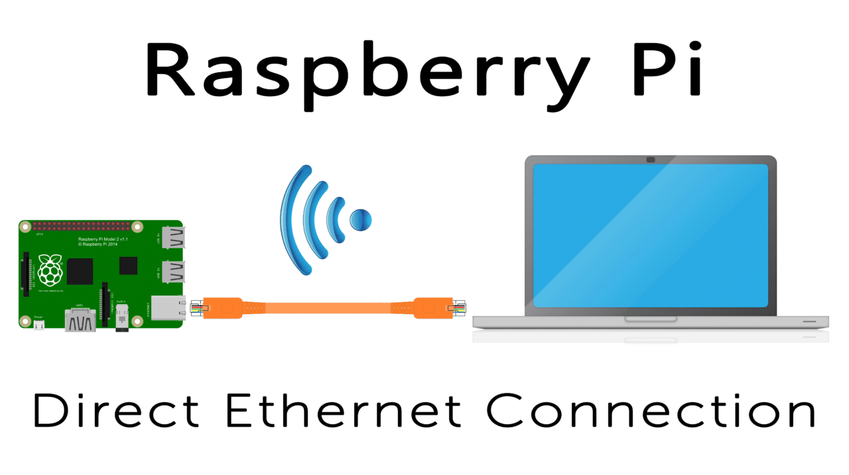
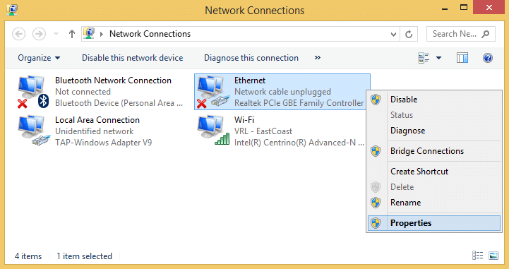
Direct Ethernet Conection
By connecting to your Pi directly from your laptop or desktop with an ethernet cable you are bypassing your local network, and you aren’t sharing bandwidth with other computers on your network. It also allows you to connect to your Pi when you’re outside of your home network
What we’re going to do is assign a static IP address to the ethernet port of the Pi. This address will depend on the IP address of the ethernet adapter on the computer you will be connecting to the Pi from.
Find the IP address of the Ethernet network adapter of your computer

Slide 20
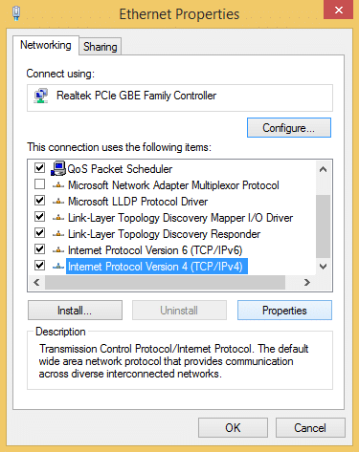
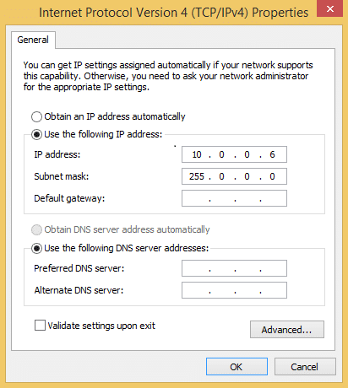
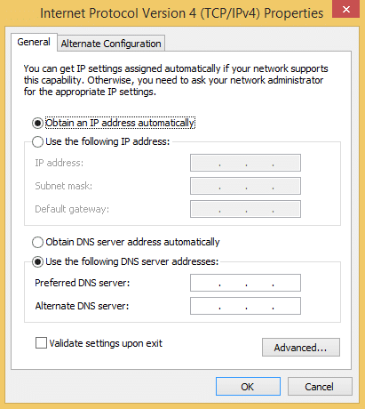
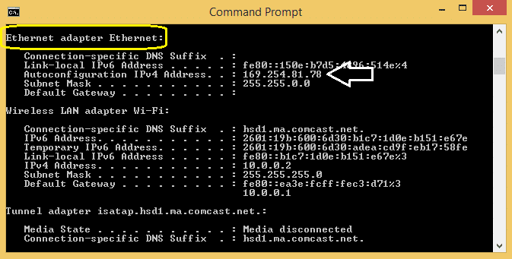
Your computer’s Ethernet IP address

Slide 21
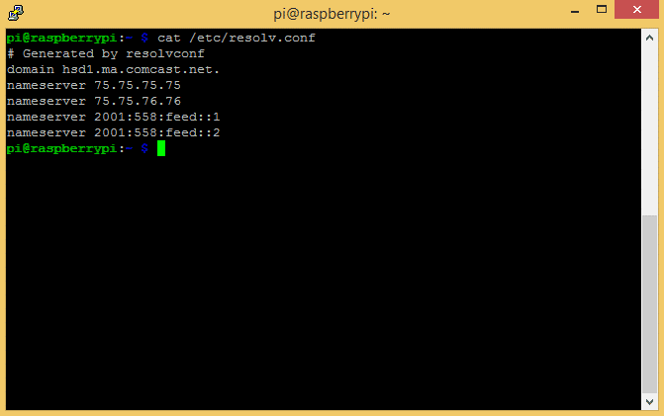
Next steps
The next step is to find out your default gateway IP. This is the local IP address of your network router. Computers on your network use it to communicate with the router and access the internet.
Now we need to find out the IP addresses of the domain name servers your Pi uses to find websites on the internet. Power up your Pi and log in to the command prompt, then enter cat /etc/resolv.conf:

Slide 22
Configuring static IP on Pi
Now we’re ready to configure the network settings on the Pi and set up our static IP address. Enter sudo nano /etc/dhcpcd.conf to edit the dhcpcd.conf file.
The three IP address are created as follows:
static ip_address – This will be the static IP address you use to SSH or remotely connect to your Pi. Take the IP address of your computer’s ethernet adapter (found in the steps above), and change the last number to any other number between 0 and 255.
static routers – This is the default gateway IP we found above.
static domain_name_servers – These are the IP’s we found in the resolv.conf file above. Separate each IP with a single space.

Slide 23
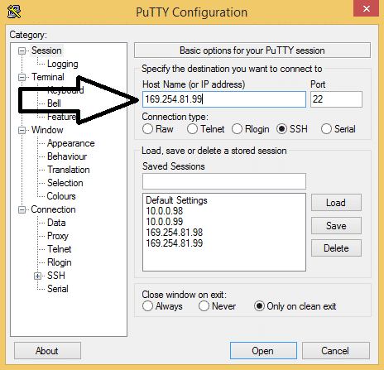
Remote access Pi – Ethernet cable
Now reboot the Pi, and plug an ethernet cable from the Pi directly to your laptop or desktop. Open PuTTY (or another SSH client) and log in with the static IP address you created above:

Slide 24
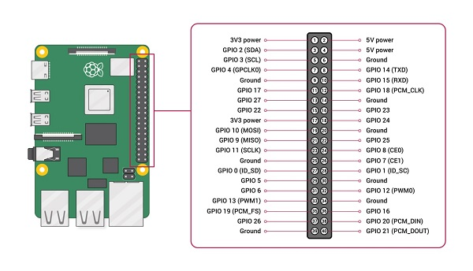
GPIO connector

Slide 25
GPIO testing using scripts
Python is an interpreted, high-level, general-purpose programming language. It is currently one of the most popular and fastest growing programming languages. The "Pi" in Raspberry Pi standards for "Python Interpreter," reflecting the fact that this is the recommended language on the platform.
A nice feature of Python is that, being an interpreter, you can type in and try commands interactively without needing to create a program. Being an interpreter there is no need to explicitly compile programs. They are compiled at run time into an intermediate bytecode which is executed by a virtual machine.

Slide 26
RPi.GPIO
RPi.GPIO, is a Python module to control the GPIO interface on the Raspberry Pi
The RPi.GPIO module is installed by default on recent versions of Raspbian Linux. To use the module from Python programs, first import it using:
import RPi.GPIO as GPIO
RPi.GPIO supports referring to GPIO pins using either the physical pin numbers on the GPIO connector or using the BCM channel names from the Broadcom SOC that the pins are connected to. For example, pin 24 is BCM channel GPIO8. To use physical board pin numbers, call:
GPIO.setmode(GPIO.BOARD)
and to use the BCM channel numbers, use:
GPIO.setmode(GPIO.BCM)

Slide 27
Rpi.GPIO
To set up a channel as an input or an output, call either:
GPIO.setup(channel, GPIO.IN)
or
GPIO.setup(channel, GPIO.OUT)
To read the value of an input channel, call:
GPIO.input(channel)
where channel is the channel number as used in setup. It will return a value of 0, GPIO.LOW, or False (all are equivalent) if it is low and 1, GPIO.HIGH, or True if it was at a high level.

Slide 28
Rpi.GPIO
To set the output state of a GPIO pin, call:
GPIO.output(channel, state)
where channel is the channel number and state is the desired output level: either 0, GPIO.LOW, or False for a low value or 1, GPIO.HIGH, or True for a high level.
When you are done with the library, it is good practice to free up any resources used and return all channels back to the safe default of being inputs. This is done by calling:
GPIO.cleanup()

Slide 29
import RPi.GPIO as GPIO
import time
led = 18
switch = 31
GPIO.setmode(GPIO.BOARD)
GPIO.setup(led, GPIO.OUT)
GPIO.setup(switch, GPIO.IN)
for i in range(10):
GPIO.output(led, GPIO.HIGH)
time.sleep(0.2)
GPIO.output(led, GPIO.LOW)
time.sleep(0.2)
print('Switch status = ', GPIO.input(switch))
GPIO.cleanup()
Here is a very simple standalone example that toggles an output pin on and off for 200 milliseconds, ten times. It also reports the level on input pin 31. If you put the commands in a file and make it executable, you can directly run it as a program.

Slide 30
We saw how we could get an input channel's level. To wait for a given level we could call GPIO.input() in a loop. The library also provides a function wait_for_edge that will block the program until a specified level is present, e.g.
GPIO.wait_for_edge(channel, GPIO.RISING)
The level can be GPIO.RISING, GPIO.FALLING, or GPIO.BOTH.
If we don't want to block waiting for an event (which is often the case in a real application with a user interface), there is support for events and callbacks. We can specify an event we are interested in:
GPIO.add_event_detect(channel, GPIO.RISING)
This will not block. At a later time we can inquire if the event has occurred by calling:
GPIO.event_detected(channel) which will return a boolean status.

Slide 31
If we want a callback function to be called when the event occurs, we can define a Python function, e.g.
def my_callback(channel):
print('This is a edge event callback function!')
print('Edge detected on channel %s'%channel)
And then specify the callback function when we call add_event_detect:
GPIO.add_event_detect(channel, GPIO.RISING, callback=my_callback)
When the event occurs, the callback will be run in another thread independent of what the program's main thread is doing.

